Slide 1
Stock Screener
Task Name: Understanding TradingView Screener and Exploring Stock Market Data
By: Rishu Raj Sinha
Email: rishuaj2401sinha@gmail.com
Rajiv Gandhi Institute Of Petroleum Technology

Slide 2
Introduction
In this presentation, we will explore the world of stock market data, including various sources of information and the essential technical indicators used in stock market analysis. We will discuss different filters and parameters for screening stocks, understand the importance of technical indicators, and explore popular sources of stock market data. Let's begin our exploration!

Slide 3
Contents
Sources of Stock Market Data
Technical Indicators in Stock Market
Analysis
Filtering Parameters for Stock Screening
Database Design
Challenges faced
References
Conclusion
Q/A Section

Slide 4
Sources of Stock Market Data
Yahoo Finance
Alpha Vantage
Other potential data sources

Slide 5
Yahoo Finance
Overview and features: Yahoo Finance is a popular platform that provides a wide range of financial information, including stock quotes, charts, news, and company profiles. It offers features such as portfolio tracking, customizable watchlists, and historical data.
Filtering options and parameters: Yahoo Finance allows users to filter stocks based on various parameters such as price range, market capitalization, sector, and financial ratios. These filters help narrow down the list of stocks based on specific criteria.
Data availability and reliability: Yahoo Finance provides real-time and historical data for stocks, including price, volume, market indices, and fundamental metrics. The platform is known for its reliable and comprehensive data, making it a trusted source for stock market information.

Slide 6
Alpha Vantage
Overview and features: Alpha Vantage is a financial data provider that specializes in offering APIs (Application Programming Interfaces) for accessing real-time and historical market data. It provides a variety of features, including time series data, technical indicators, fundamental data, and sector performance analysis.
API capabilities and data endpoints: With Alpha Vantage's APIs, developers can programmatically retrieve stock market data. The APIs offer multiple endpoints that grant access to diverse data sets. These include price and volume data, company fundamentals, technical indicators, and more. Users can leverage these endpoints to gather the desired information for their analysis.
Support for technical indicators and filters: Alpha Vantage provides an extensive range of technical indicators that are valuable for stock market analysis. These indicators encompass moving averages, RSI (Relative Strength Index), MACD (Moving Average Convergence Divergence), and Bollinger Bands. Moreover, Alpha Vantage allows users to apply filters based on specific criteria, enabling them to screen stocks based on their desired parameters.
Overall, Alpha Vantage's APIs empower developers with the capability to access real-time and historical market data, utilize technical indicators, and apply filters to streamline stock market analysis processes.

Slide 7
Other potential data sources
Bloomberg Terminal: Range of financial data, news, analytics, and trading tools.
Google Finance: Stock quotes, charts, news updates, and general market data.
Quandl: Collection of financial, economic, and alternative data
Interactive Brokers: Providing access to real-time market data, trading platforms, and research tools

Slide 8
Technical Indicators in Stock Market Analysis
Moving Averages
Relative Strength Index (RSI)
Moving Average Convergence Divergence (MACD)
Other notable technical indicators

Slide 9
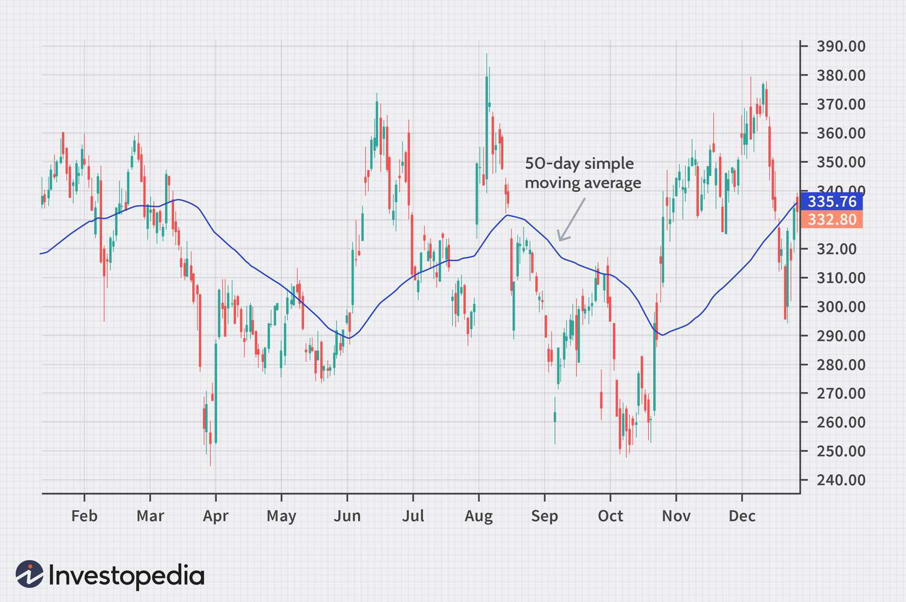
Moving Averages
Moving Averages (MA) are popular tools in stock market analysis. The two main types are Simple Moving Average (SMA) and Exponential Moving Average (EMA).
SMA calculates the average stock price over a specified period by summing up closing prices and dividing by the number of periods. It smooths out short-term fluctuations.
EMA places more weight on recent prices, making it responsive to recent changes. It assigns greater significance to the most recent data points.
Moving averages help identify trends in stock prices and provide a visual representation of the overall direction.

Slide 10
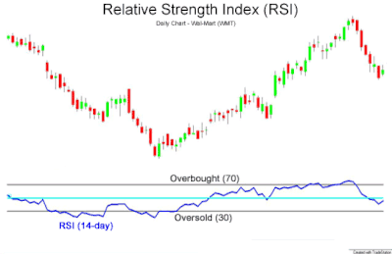
Relative Strength Index (RSI)
RSI (Relative Strength Index) is calculated by comparing the average gain and average loss over a specified period. It generates a value between 0 and 100.
RSI helps identify potential reversals in price direction.
It also confirms momentum

Slide 11
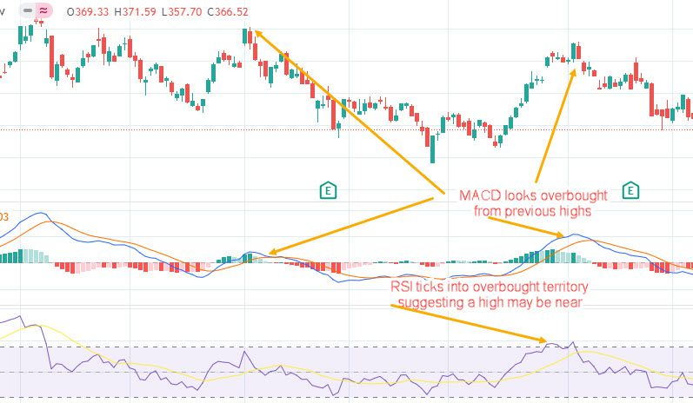
Moving Average Convergence Divergence
MACD (Moving Average Convergence Divergence) is calculated by subtracting the 26-day Exponential Moving Average (EMA) from the 12-day EMA.
Signal crossovers: MACD signal line crossovers with the MACD line indicate potential buying or selling opportunities
Divergence analysis: Divergence happens when the MACD line and the stock price move in opposite directions

Slide 12
Other notable technical indicators
Bollinger Bands: They consist of a moving average and two standard deviation lines
Stochastic Oscillator: It compares a stock's closing price to its price range over a specified period.
Average Directional Index (ADX): ADX measures the strength of a trend.
Fibonacci Retracement: It helps identify potential support and resistance levels based on Fibonacci ratios

Slide 13
Filtering Parameters for Stock Screening
Price-related filters:
Minimum and maximum price range
Price-to-Earnings (P/E) ratio
Dividend yield
Volume-related filters:
Average daily volume
Volume surge or unusual volume activity
Fundamental filters:
Market capitalization
Earnings per share (EPS)
Debt-to-Equity ratio (D/E)

Slide 14
Database Design
This design involves creating a table named "stock_data" with the following columns:
Date: A primary key column that stores the date of the stock data.
Open: Stores the opening price of the stock.
High: Stores the highest price reached during the day.
Low: Stores the lowest price reached during the day.
Close: Stores the closing price of the stock.
Adj_Close: Stores the adjusted closing price of the stock, if applicable (accounts for events such as stock splits or dividends).
Volume: Stores the trading volume of the stock, representing the number of shares traded during the day.

Slide 15
50-day MA: Stores the value of the 50-day moving average indicator, which calculates the average price over the past 50 days.
RSI: Stores the value of the relative strength index indicator, which measures the magnitude of recent price changes to determine overbought or oversold conditions.
12-day EMA: Stores the value of the 12-day exponential moving average indicator, which gives more weight to recent prices.
26-day EMA: Stores the value of the 26-day exponential moving average indicator, which gives more weight to recent prices.
MACD Line: Stores the value of the MACD line, which is calculated by subtracting the 26-day EMA from the 12-day EMA.
Signal Line: Stores the value of the signal line, typically a 9-day EMA of the MACD line.
Histogram: Stores the value of the histogram, representing the difference between the MACD line and the signal line.

Slide 16
Challenges Faced
API Integration and Documentation
Data Parsing and Formatting
Data Storage and Database Design
Security and Authentication
Technical Jargon

Slide 17
References
https://in.tradingview.com/screener/
https://finance.yahoo.com/
https://www.alphavantage.co/documentation/

Slide 18
Conclusion
In conclusion, understanding different sources of stock market data
and the significance of technical indicators is crucial for effective
stock market analysis. By exploring various data sources like
Yahoo Finance and Alpha Vantage, and learning about technical
indicators such as moving averages, RSI, and MACD, one can gain
valuable insights into stock selection and trading strategies.
Research and analysis are key to successful
stock market investing.

Slide 19
Q/A section
Now I am done form my side and I am ready to answer any question if someone have?

Slide 20
Thank you

